Slide 1

FINAL REVIEW
PureBreath-AI
An Explainable AI Framework for AQI Forecasting, Personalized Pollution Exposure Assessment, and Health-Risk Prediction
PRESENTED BY
Surya J (23619118)
Karun C (23619119)
Sanjay S (23619133)
MENTOR
Dr. K. Ulaga Priya M.E., Ph.D
Department of Artificial Intelligence and Machine Learning
Vels Institute of Science, Technology & Advanced Studies (VISTAS), Chennai

Slide 2
Problem & Objectives
INTRODUCTION
The Problem
Our Objectives
AQI apps show a number, but not why it is high.
Advice is generic and ignores age, asthma, pregnancy or time spent outdoors.
Single-day AQI hides the cumulative effect of days of exposure.
Black-box forecasts are hard to trust for health decisions.
Forecast AQI accurately for five Indian cities.
Explain every prediction with SHAP and what-if counterfactuals.
Score personal health risk from user profile and AQI.
Track 7-day cumulative exposure with tiered alerts.
Deliver everything in one working web application.

Slide 3
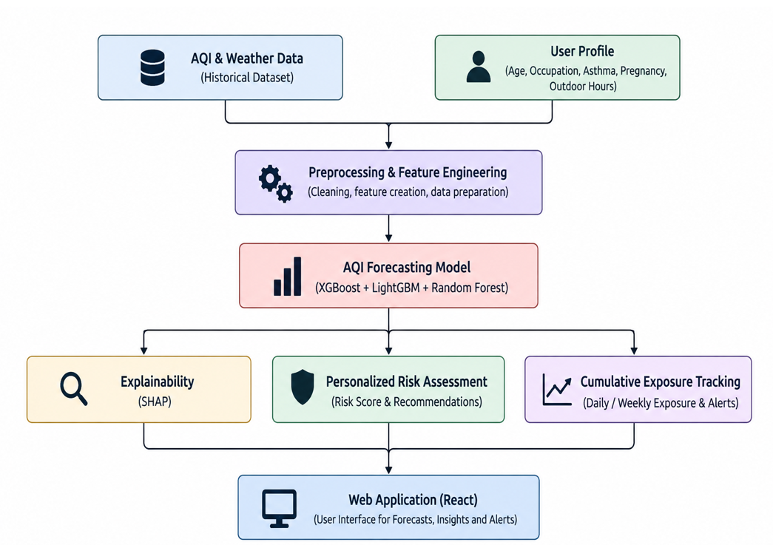
System Architecture
ARCHITECTURE
1. Data Layer
CPCB AQI + weather data for five Indian cities.
2. Forecasting
GAN balancing + XGBoost + LightGBM + Random Forest.
3. Explainability
SHAP attribution + model-based counterfactuals.
4. Personalization
Risk score + cumulative exposure + alerts + React dashboard.

Slide 4
Dataset & Preprocessing
IMPLEMENTATION
10,960
3,000
55
5
cleaned real records
GAN-generated records
forecasting features
cities covered
Source & Coverage
Preprocessing
CPCB daily air-quality data + meteorological data.
Delhi, Mumbai, Chennai, Kolkata and Bangalore.
Interpolation + forward/backward fill for missing values.
Duplicate city-date records removed; negatives clipped.
Calendar, lag and rolling-statistic features created.

Slide 5
Forecasting Models & GAN Augmentation
IMPLEMENTATION
Model Inputs
Models Trained
Conditional GAN
Historical AQI
Pollutant features
Weather features
Lag features
Rolling statistics
City features
XGBoost
LightGBM
Random Forest
Target: CPCB-standard AQI
80/20 holdout split
PyTorch implementation.
500 synthetic samples per AQI class.
Independent gain not isolated by ablation, so no accuracy gain is claimed.

Slide 6
Final Forecasting Results
PERFORMANCE ANALYSIS
Model | MAE | RMSE | R² | MAPE
LightGBM | 1.71 | 2.37 | 0.9996 | 0.58%
XGBoost | 2.20 | 3.16 | 0.9994 | 0.80%
Random Forest | 3.61 | 6.75 | 0.9971 | 1.98%
Best Holdout Model
LightGBM: R² 0.9996, MAE 1.71, RMSE 2.37.
Based on a random 80/20 holdout split; walk-forward validation is the next step.
Same MAE/RMSE scale as AQI points on the CPCB index.

Slide 7
Explainability: SHAP & Counterfactuals
XAI
162/200
cases gave lower predicted AQI
SHAP on LightGBM
TreeExplainer: global importance + local contributions.
200 rows: 100 high-AQI (≥ 200) + 100 others.
Main drivers: PM2.5, PM10, mean temperature, 7-day PM10 std, min temperature.
24/200
cases changed AQI category
Counterfactual Method
Take top positive SHAP contributors.
Reduce each by 20% and re-run the model.
Compare original vs modified AQI.
29.9
mean AQI-point reduction
Counterfactuals describe model behavior, not proven real-world causal effects.

Slide 8
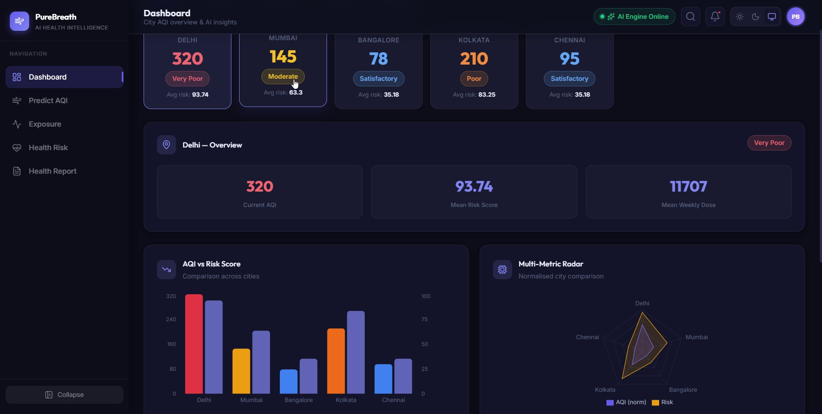
Final Application: Dashboard
PROTOTYPE
City AQI Cards
Live AQI, category and average risk for all five cities.
City Overview
Current AQI, mean risk score and mean weekly dose.
Comparison Charts
AQI vs risk bars and a multi-metric radar.

Slide 9
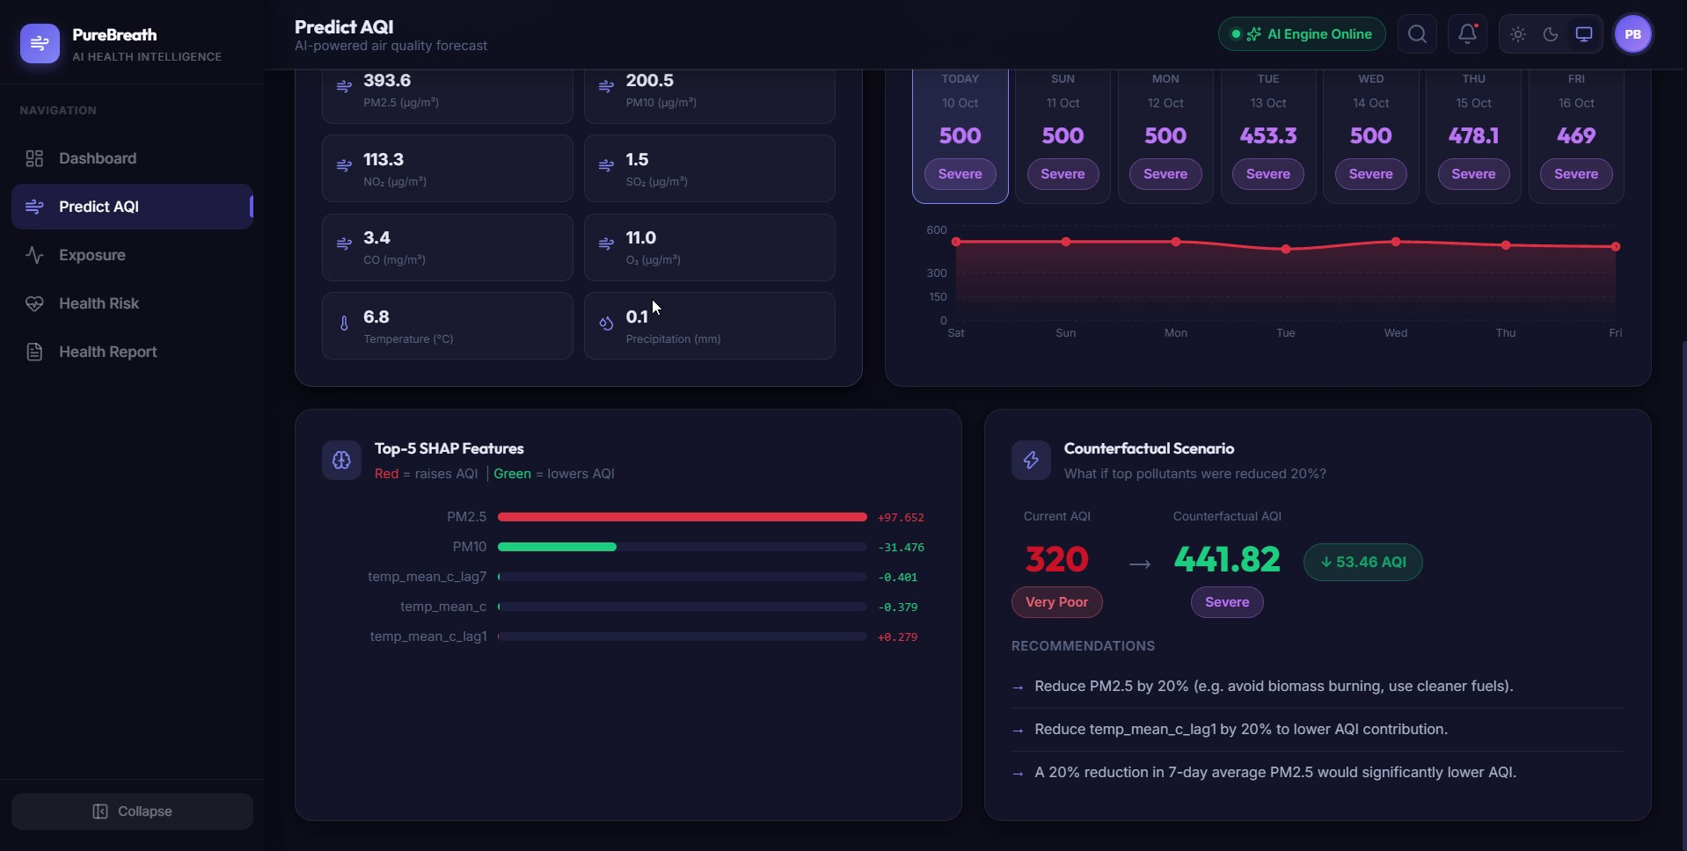
Final Application: AQI Prediction
PROTOTYPE
Inputs & 7-Day Forecast
Pollutant and weather inputs drive the AQI forecast.
Top-5 SHAP Features
Red raises AQI, green lowers it. PM2.5 leads.
Counterfactual Panel
What-if 20% pollutant cut, with recommendations.

Slide 10
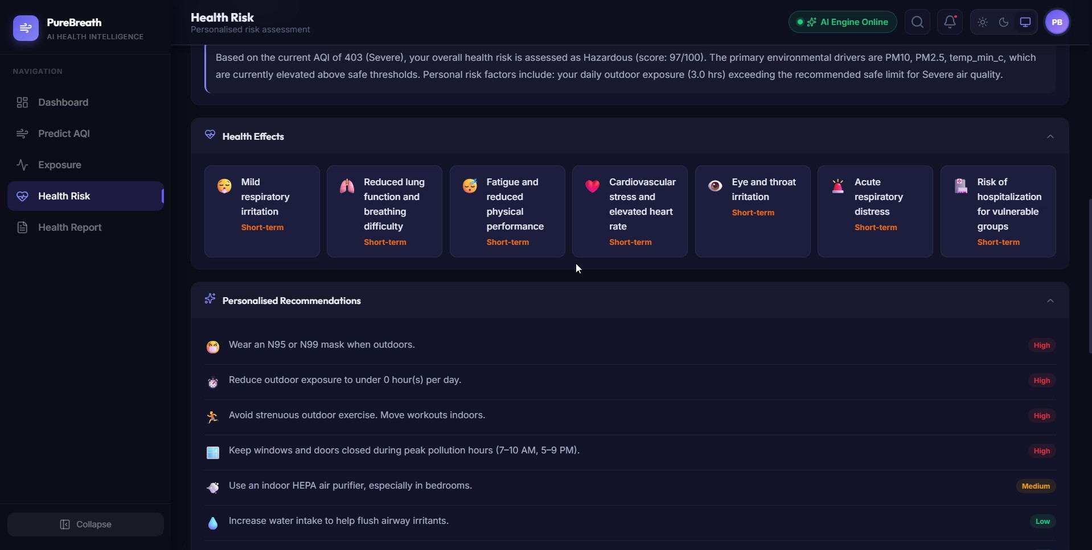
Final Application: Personalized Health Risk
PROTOTYPE
Risk Summary
Risk score out of 100 from AQI, age, outdoor hours and conditions.
Health Effects
Likely short-term effects for the current AQI level.
Recommendations
Prioritised High / Medium / Low advice.

Slide 11
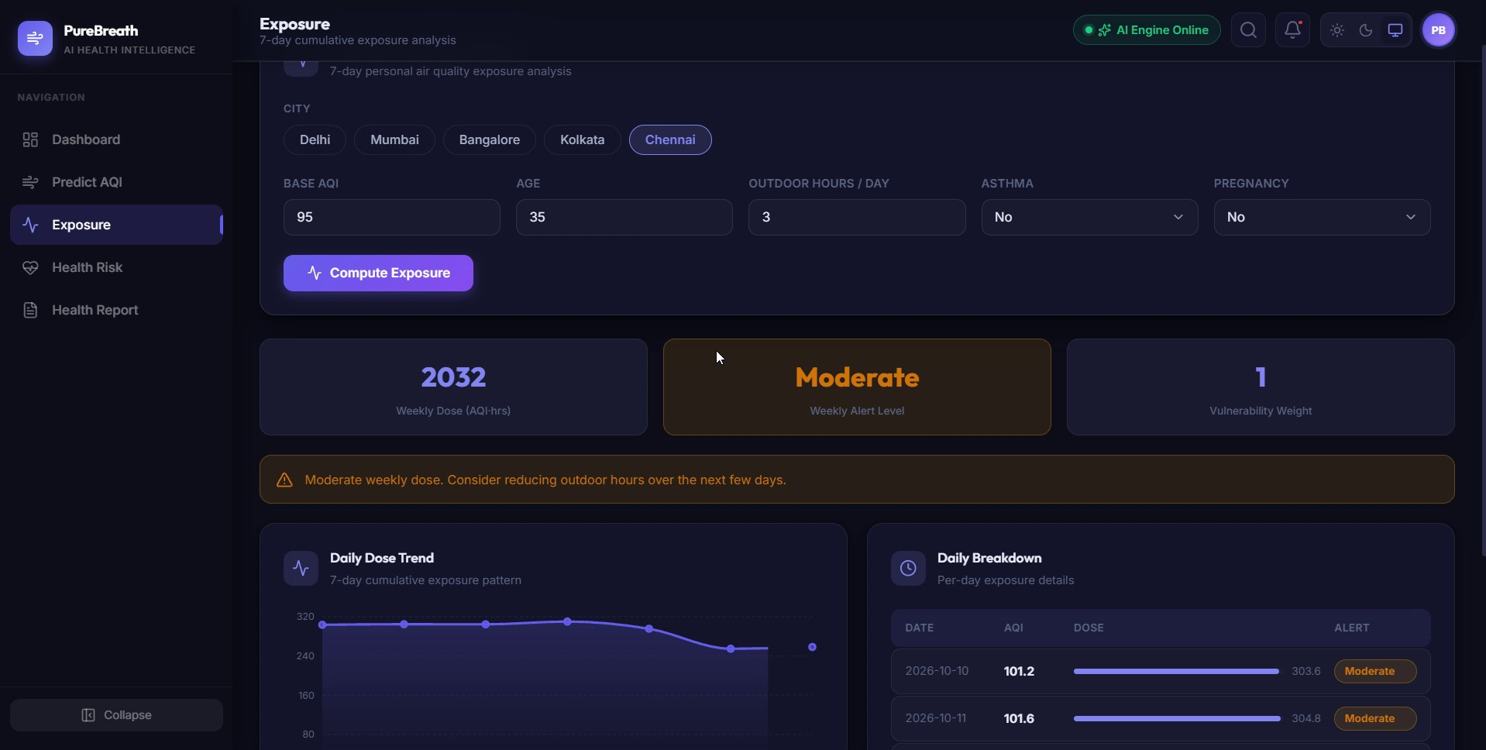
Final Application: Cumulative Exposure
PROTOTYPE
User Profile Inputs
City, base AQI, age, outdoor hours, asthma, pregnancy.
Weekly Dose & Alert
Dose = AQI × hours × vulnerability; tiered alert level.
Daily Breakdown
Per-day dose trend with Safe to Critical alert tiers.

Slide 12
End-to-End Flow
INTEGRATION
1
›
2
›
3
›
4
›
5
›
6
Dashboard
Predict AQI
SHAP
Counterfactual
Health Risk
Exposure
Tech Stack
Risk & Exposure Engine
FastAPI backend serving model, SHAP and risk endpoints.
React + Vite frontend dashboard.
LightGBM forecasting model at the core.
Rule-based risk: AQI category × age × occupation × outdoor × conditions, capped at 100.
Weekly dose = sum of 7 daily doses; Safe, Moderate, High, Critical.

Slide 13
Testing & Validation Status
EVALUATION
Component | Status | Evidence
AQI Forecasting | Validated | MAE / RMSE / R² / MAPE on holdout
SHAP + Counterfactual | Validated | 200-row evaluation
Personalized Risk | Implemented | Rule-based
Cumulative Exposure | Implemented | Threshold logic verified; 7-day path simulated
API + Dashboard | Implemented | Functional integration verified

Slide 14
Limitations & Future Work
NEXT STEPS
Walk-forward validation
Clinical validation
Current result uses a random 80/20 split; add time-aware validation.
Check risk weights against clinical or epidemiological evidence.
True 7-day forecast
Replace the simulated exposure path with multi-day forecasting.

Slide 15
Conclusion
FINAL REVIEW
What We Built
What We Demonstrated
AQI forecasting for five cities
Explainable AI with SHAP
Counterfactual what-if analysis
Personalized health risk
Cumulative exposure + alerts
FastAPI + React web application
LightGBM: R² 0.9996, MAE 1.71, RMSE 2.37.
162/200 counterfactual cases lowered AQI; 24 changed category.
A complete pipeline running end to end in one application.

Slide 16
THANK YOU
PureBreath-AI • Final Review
Surya J (23619118) • Karun C (23619119) • Sanjay S (23619133)
Mentor: Dr. K. Ulaga Priya M.E., Ph.D

